Slide 1
Microsoft Needs Analysis
Christian Corrales and Ijeoma Akamnonu
November 13, 2020

Slide 2
Summary
The compilation of movie data from IMDb and Box Office Mojo has provided some insight as to the best way Microsoft can go about producing a successful debut in the film industry with their first film:
Modeling after successful films
Precisely targeting the audience
Optimizing gross earnings for release

Slide 3

Outline
Business Problem
Data
Methods
Results
Conclusions

Slide 4

Business Problem
How can Microsoft’s first film be the best it can be?
Hardened and tested films currently available
Film type
Projected success

Slide 5
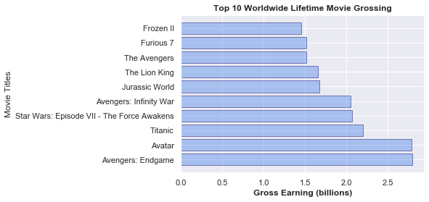
Data
Insights generated using data from IMDb and Box Office Mojo
B.O.M provided:
Worldwide Lifetime Grossing
includes Domestic and Foreign Lifetime Grossing
Year of movie release
IMDb provided:

Slide 6
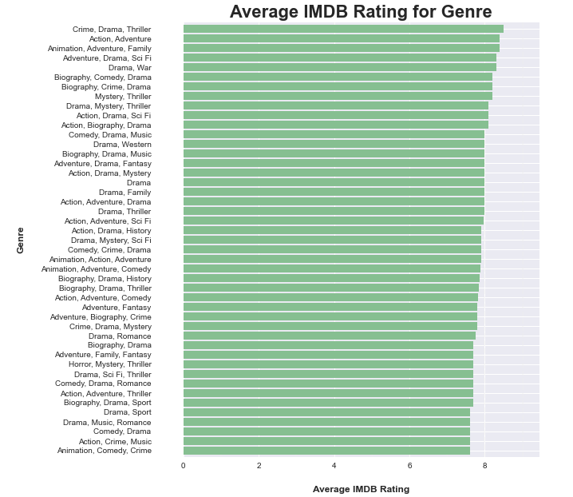
Methods
Data collection through web scraping
Cleaned and analyzed data frames based on scraped data
Gained results and formed conclusions
Why is this approach appropriate given the data and the business problem?

Slide 7
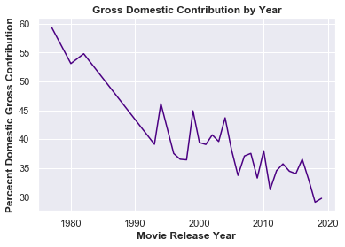
Results 1
As time progresses, average movie success (worldwide gross earnings) can be mostly attributed to overseas revenue.

Slide 8
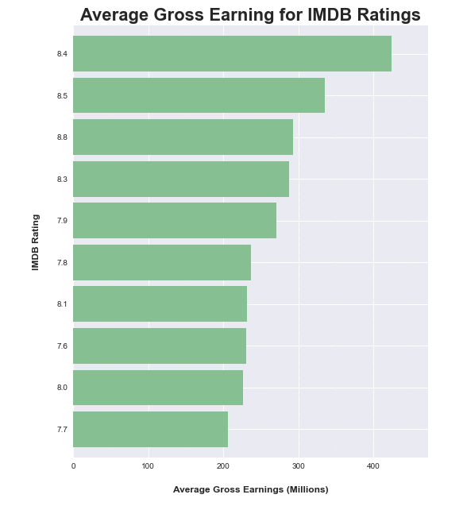
Results 2

Slide 9
Deductions
Conclusion
Next…
Who can we mimic?
Who is our target?
Genre
Release location
Overseas collaborations?
Projected earnings
Further steps to consider for optimal results
Budget
Cast/Crew consideration
Release locations

Slide 10

Christian Corrales
Email:
GitHub: @ccorrales1228
Ijeoma Akamnonu
Email: inakamno@buffalo.edu
GitHub: @aamoeji04

